Slide 1
Group 7:
Pizza Ordering Application
Evan Williams
Timon Wood
Michael Wong
Mark Zeagler • Summer Semester 2017

Slide 2
Overview
Starting date:
June 5, 2017
Major Developments
We have created a program that allows the user to order a pizza using a database that stores their information
We have also documented our progress and major developments as per our requirements listed
Overall Progress
For the most part, we have made significant progress with our project. Our application is functional, and our documentation is adequately prepared.

Slide 3
Development Stage - Planning the Project
Accomplishment 1
Before starting this project, we unanimously agreed on every group member’s role regarding how to proceed with the project.
From then on, we began to work on the heart of our project.
Accomplishment 2
During the [brief] planning phase, the documenter also created the Project Plan, one of the more significant documents that is required of this project.
It took a week to complete.

Slide 4
Development Stage - Preparing the Class Objects
Accomplishment 1
Upon beginning our project, one of our group members was assigned to work on some classes for our application.
Within the next couple of weeks, he has managed to do so accordingly.
Accomplishment 2
Within each class are a set of methods that each serves a significant purpose for our application. This has aided the GUI scripter immensely with his work.

Slide 5
Development Stage - Creating the GUI
Accomplishment 1
Creating the GUI was a daunting task that somewhat required the utmost attention and patience.
Although basic, the functionality of this GUI required quite a bit of problem solving.

Slide 6
Development Stage - Creating the Database
Accomplishment 1
Creating the database was also a daunting task, but once completed, it allowed the user to save their credentials under our SQL database.
Accomplishment 2
Using this newly formed database, the user can access their account and make purchases without needing to fill in their credentials every time they would like a new pizza.

Slide 7
Development Stage - Documenting our Findings
Accomplishment 1
For our final task, we were required to document our findings and developments.
The documentation process began once our project was nearly complete, which proved to be an error.
Accomplishment 2
Regardless, documenting everything was somewhat of a breeze and took no more than two or three weeks of steady work to finish off.

Slide 8
Schedule

Slide 9
Assuming that a basic GUI is complete, begin work on SQL database; try to have finished by July 12th.
Begin project; work on and complete project plan before June 12th.
Finalize project, and present the project
06.05.17
06.12.17
06.24.17
07.12.17
07.19.17
Begin working on the class objects and their methods; begin work on GUI as well.
Document findings and progress, and create various of the required documents; begin testing application

Slide 10
Documentation

Slide 11
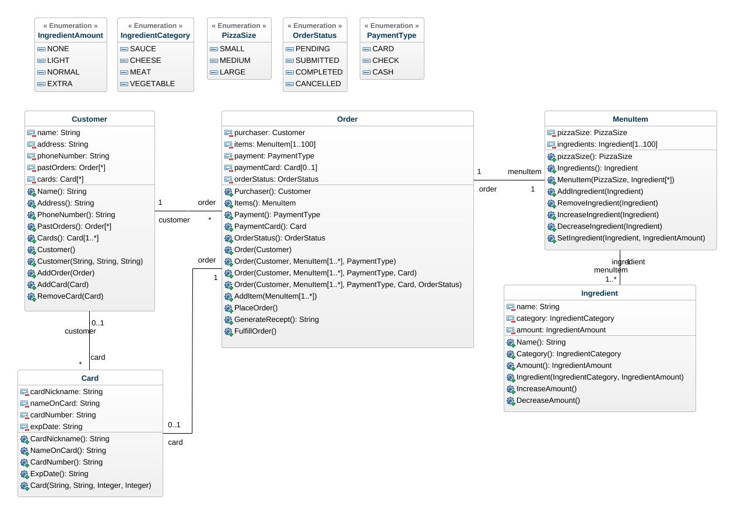
Class Diagrams
The Class Diagrams are an important foundation for our project which allowed one of our developers to create our program’s class objects with ease.

Slide 12
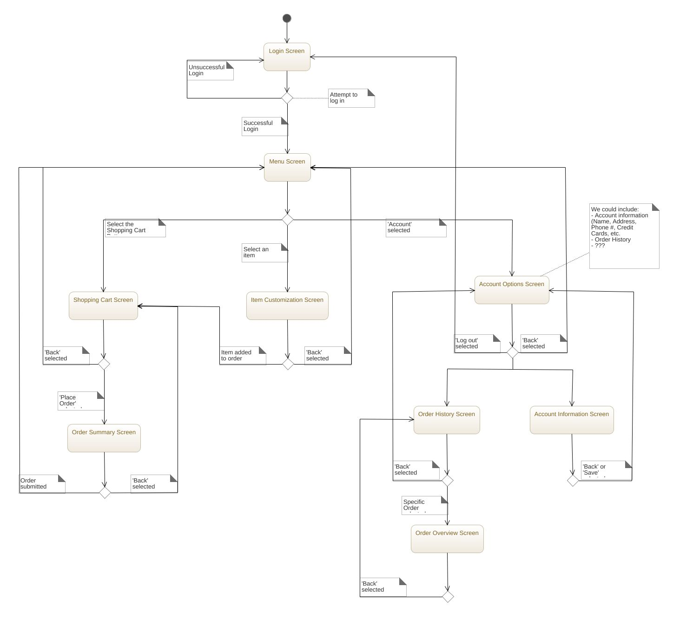
Behavior State Diagram
The Behavior State Diagram is a diagram which shows the process by which a user may navigate our application and place their order. This laid the foundation for our project.

Slide 13
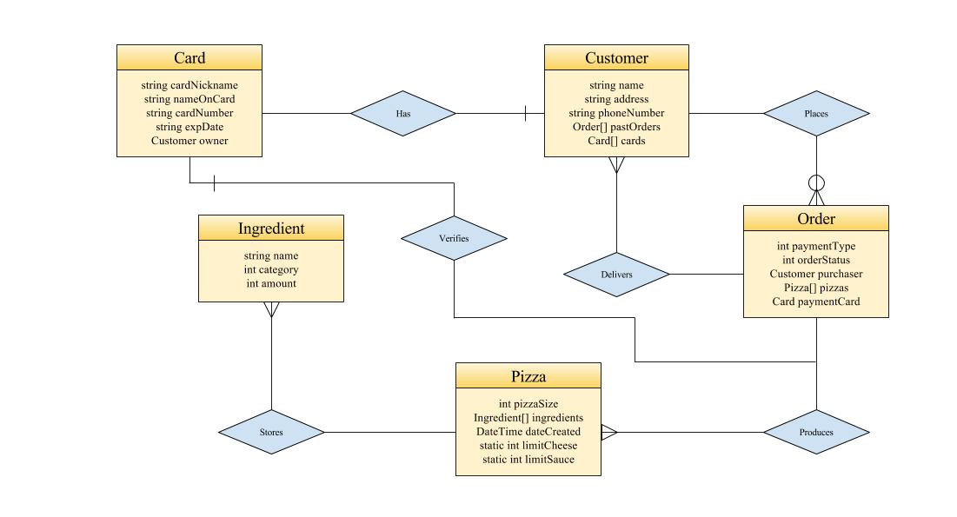
Entity Relationship Diagram
The Entity Relationship Diagram is a diagram which shows relationship within various entities of our program. Since our program is relatively small, with few entities, the diagram was thus small as well.

Slide 14
What does our project look like now?
Now that we have talked about how we went about completing this project, we will now briefly demonstrate how our application functions.

Slide 15
Final Remarks and Questions

